Slide 1
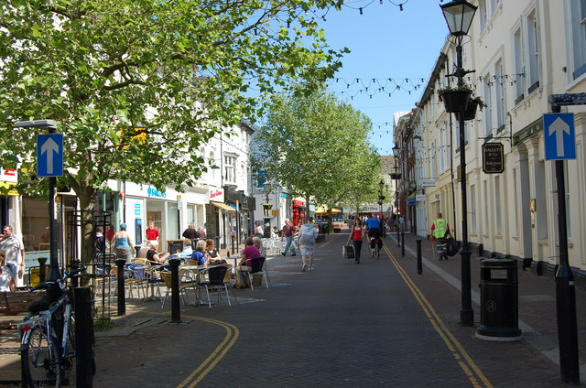
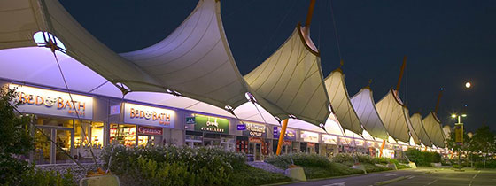
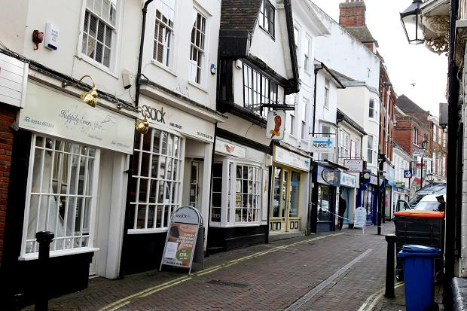
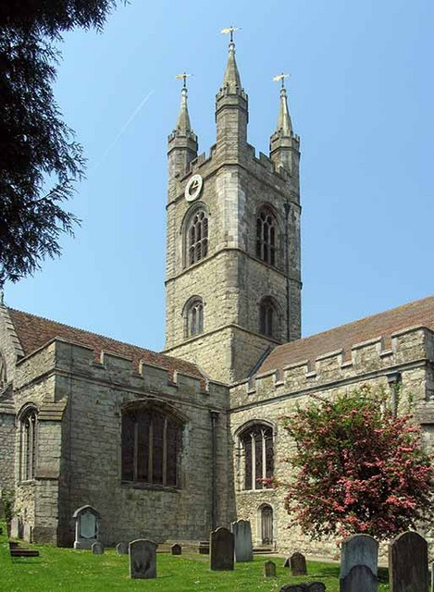
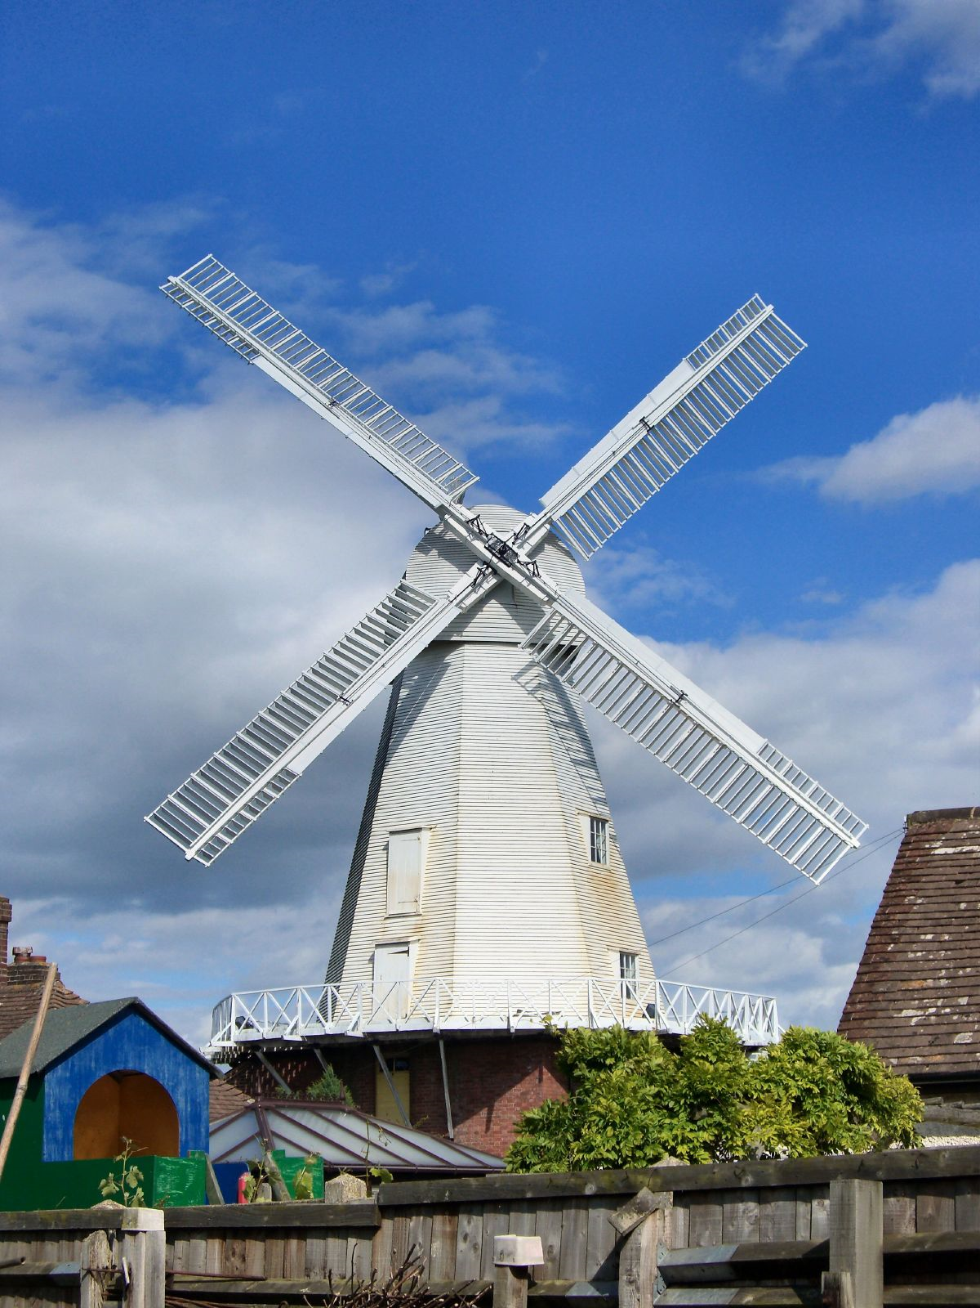
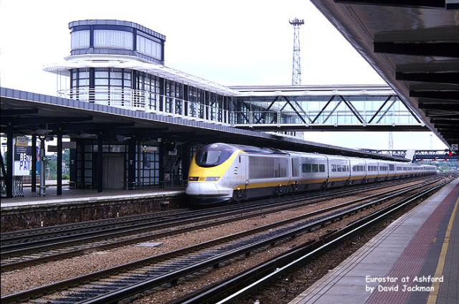
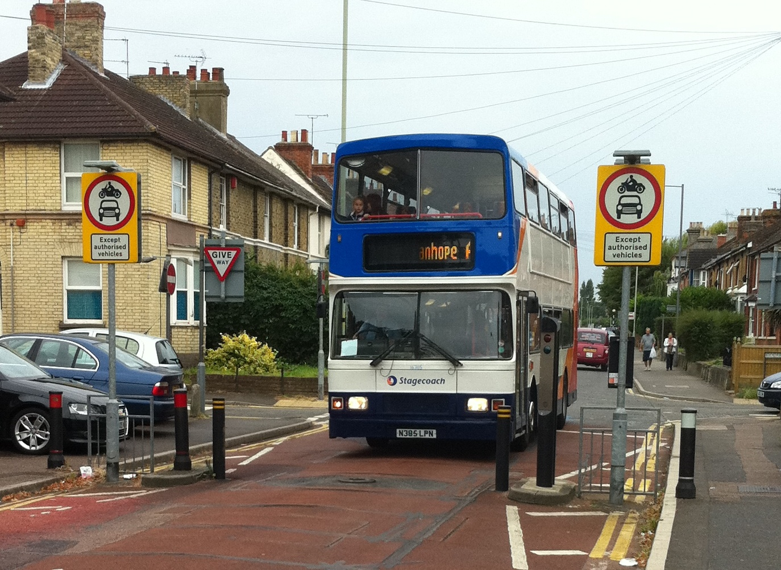
Welcome to
ASHFORD

Slide 2
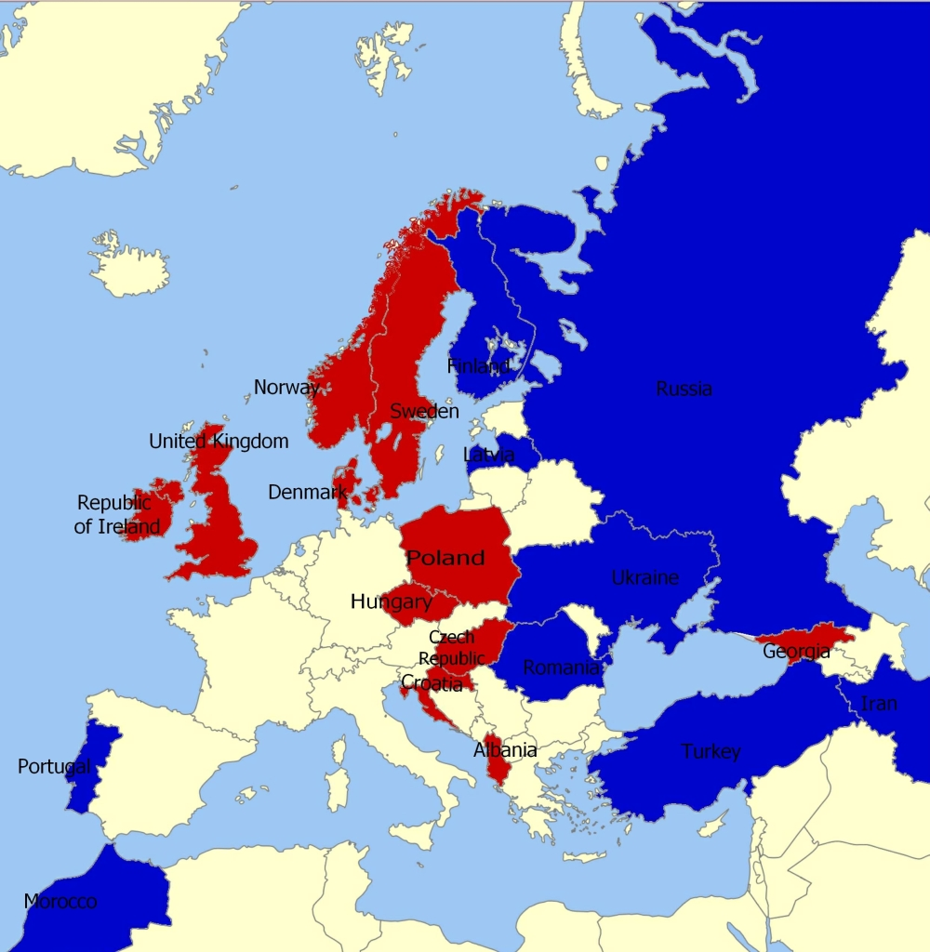
Where
are
we?

Slide 3
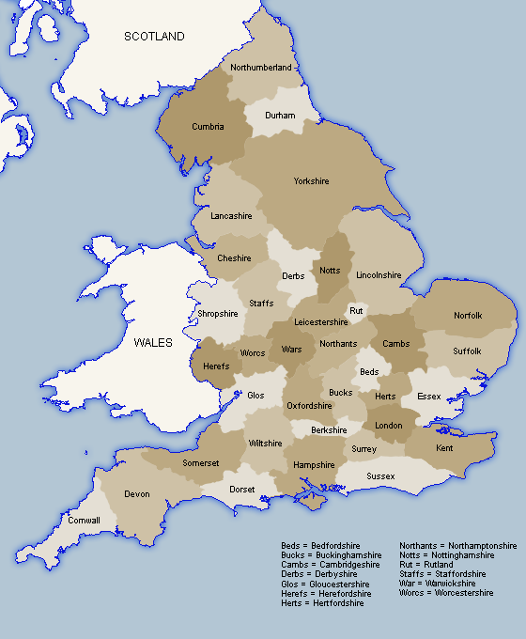
Ashford is in the South-East of England, in a county called Kent.

Slide 4
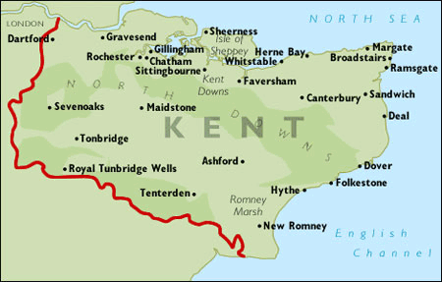
These are the main towns in Kent. As you can see, there is plenty of countryside and coastline to enjoy.

Slide 5
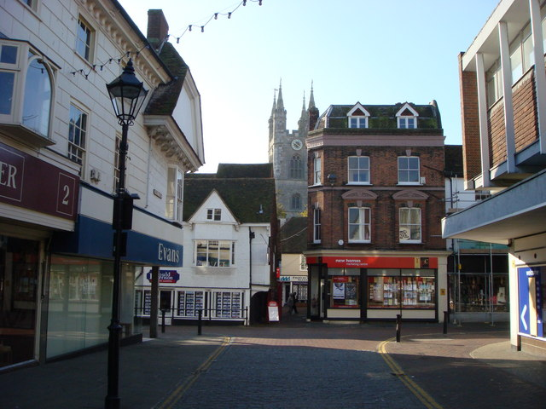
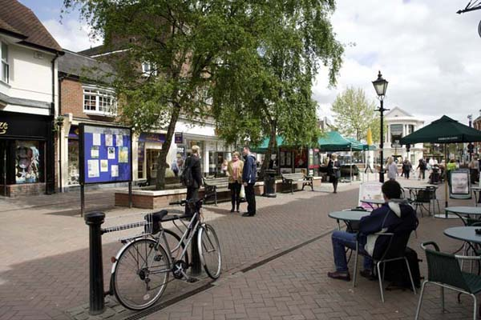
Ashford is a market town. There are plenty of shops, restaurants and other amenities, such as churches, schools and travel agents.
In 2011, Ashford had a population of 74,204. This compares to a population of 129,322 in Tychy (in 2013).

Slide 6
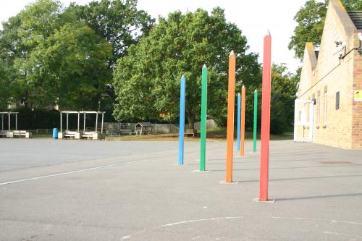
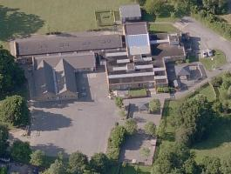
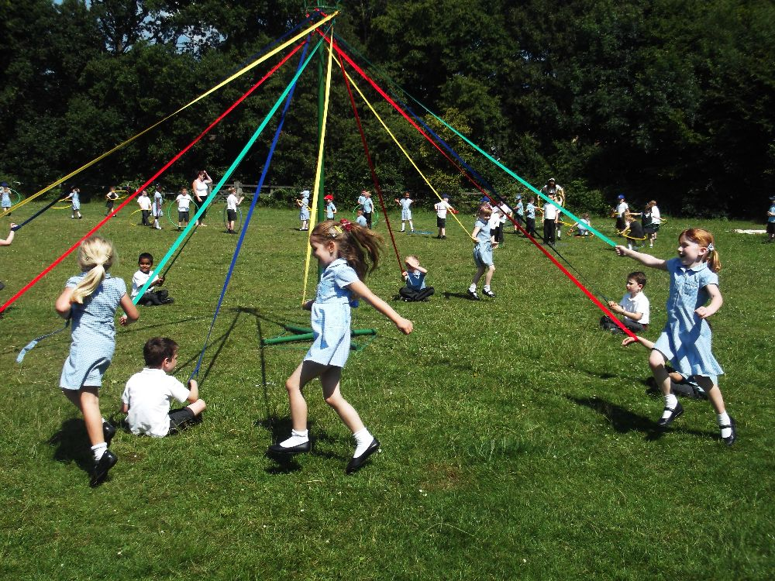
Our school is near to the centre of Ashford, but as you can see, we have plenty of space to play on our playgrounds and our field. We have 420 children at our school with two classes in each year group, from Reception (4 year olds) to Year 6 (11 year olds).

Slide 7
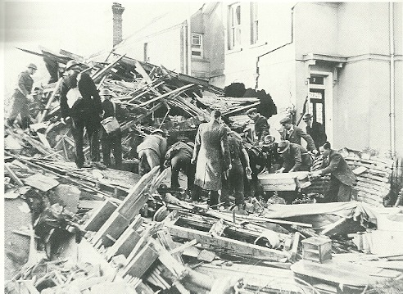

Slide 8
Here is an excerpt from a report written during the second world war:
March 25th 1943: In the last few weeks, Kent has suffered badly from the reprisal raids caused by RAF Bomber Command's increased activity over Germany. Yesterday it was Ashford's turn. The raid lasted just 3 minutes but in that time 50 people were killed and 77 seriously injured, many by the machine guns which strafed the streets as people fled for safety. One bomb fell on the Victoria Road Primary School but the 300 children were already in the shelters.
They were not so lucky at the Ashford Railway Works where 5 were killed and 50 ton locomotives in the erecting shed were totally mangled.
The worst damage was at Milton Road, New Street (where 2 died in Hayward's Garage), Dover Place, New Rents, Star Road, Hardinge Road and Kent Avenue, where 5 were killed in a baker’s shop.
In terms of lives lost in a single raid this was Kent's worst blow of the war. It is believed the attacking Focke-Wulf190s belonged to Staffel JG26 from St Omer and were led by Paul Keller, nicknamed "Bombenkeller".
To the satisfaction of the Ashford gunners, Keller did not survive the raid. His Focke-Wulf was hit by Ack Ack fire and crashed in Godinton Road.

Slide 9
During the 20th century Ashford continued to grow rapidly. By 1951 Ashford had nearly 25,000 inhabitants.
During the Second World War, 83 people were killed in Ashford by German bombing but the town continued to flourish. Ashford bypass was built in 1957. The Stour Centre opened in 1978 and a new Civic Centre opened in 1983.
At the end of the 20th century the Channel Tunnel opened and it spurred the growth of Ashford. Today the population of Ashford is 59,000.

Slide 10
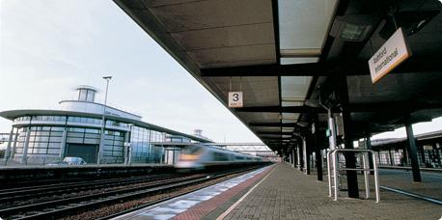
Ashford International Station

Slide 11
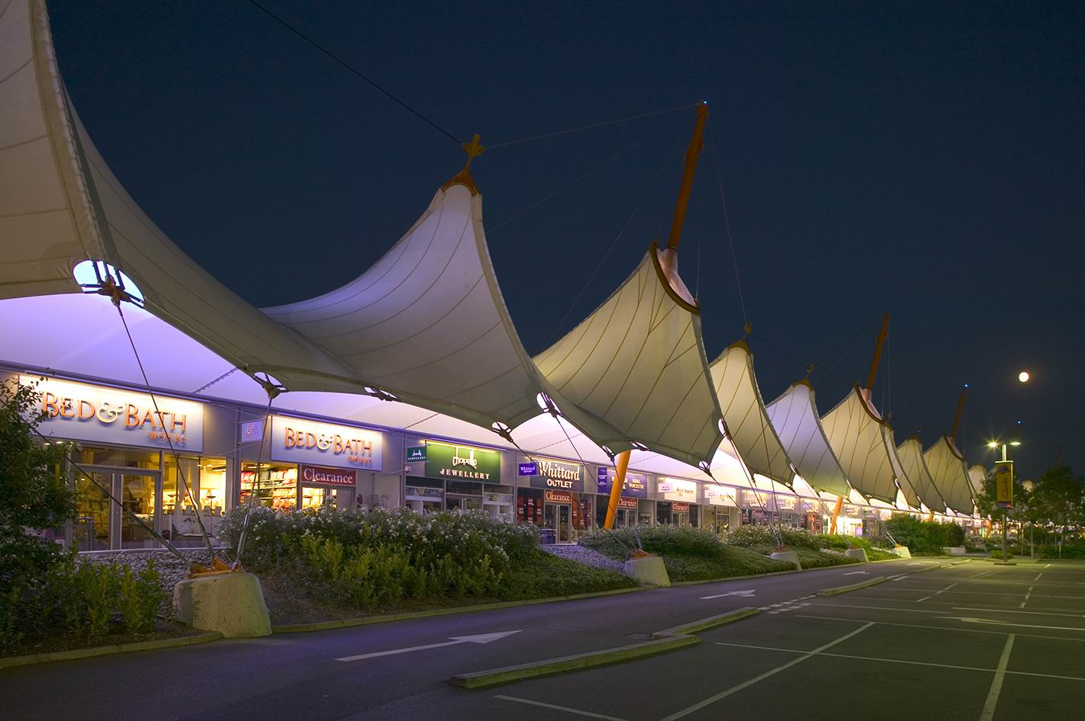
Ashford Designer Outlet

Slide 12
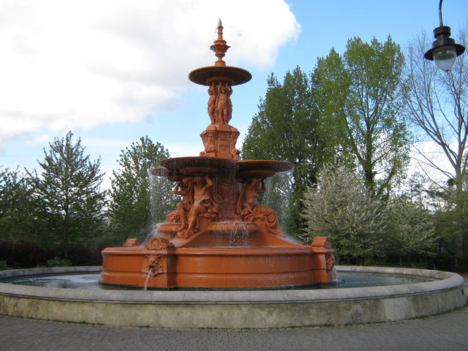
Victoria Park

Slide 13
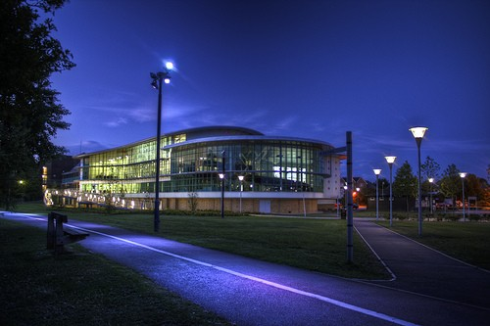
The Stour Centre

Slide 14
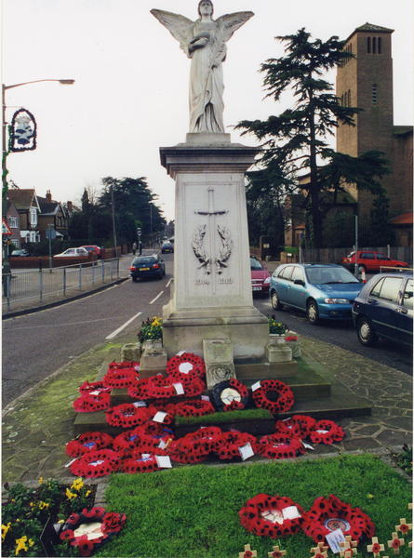
War Memorial

Slide 15
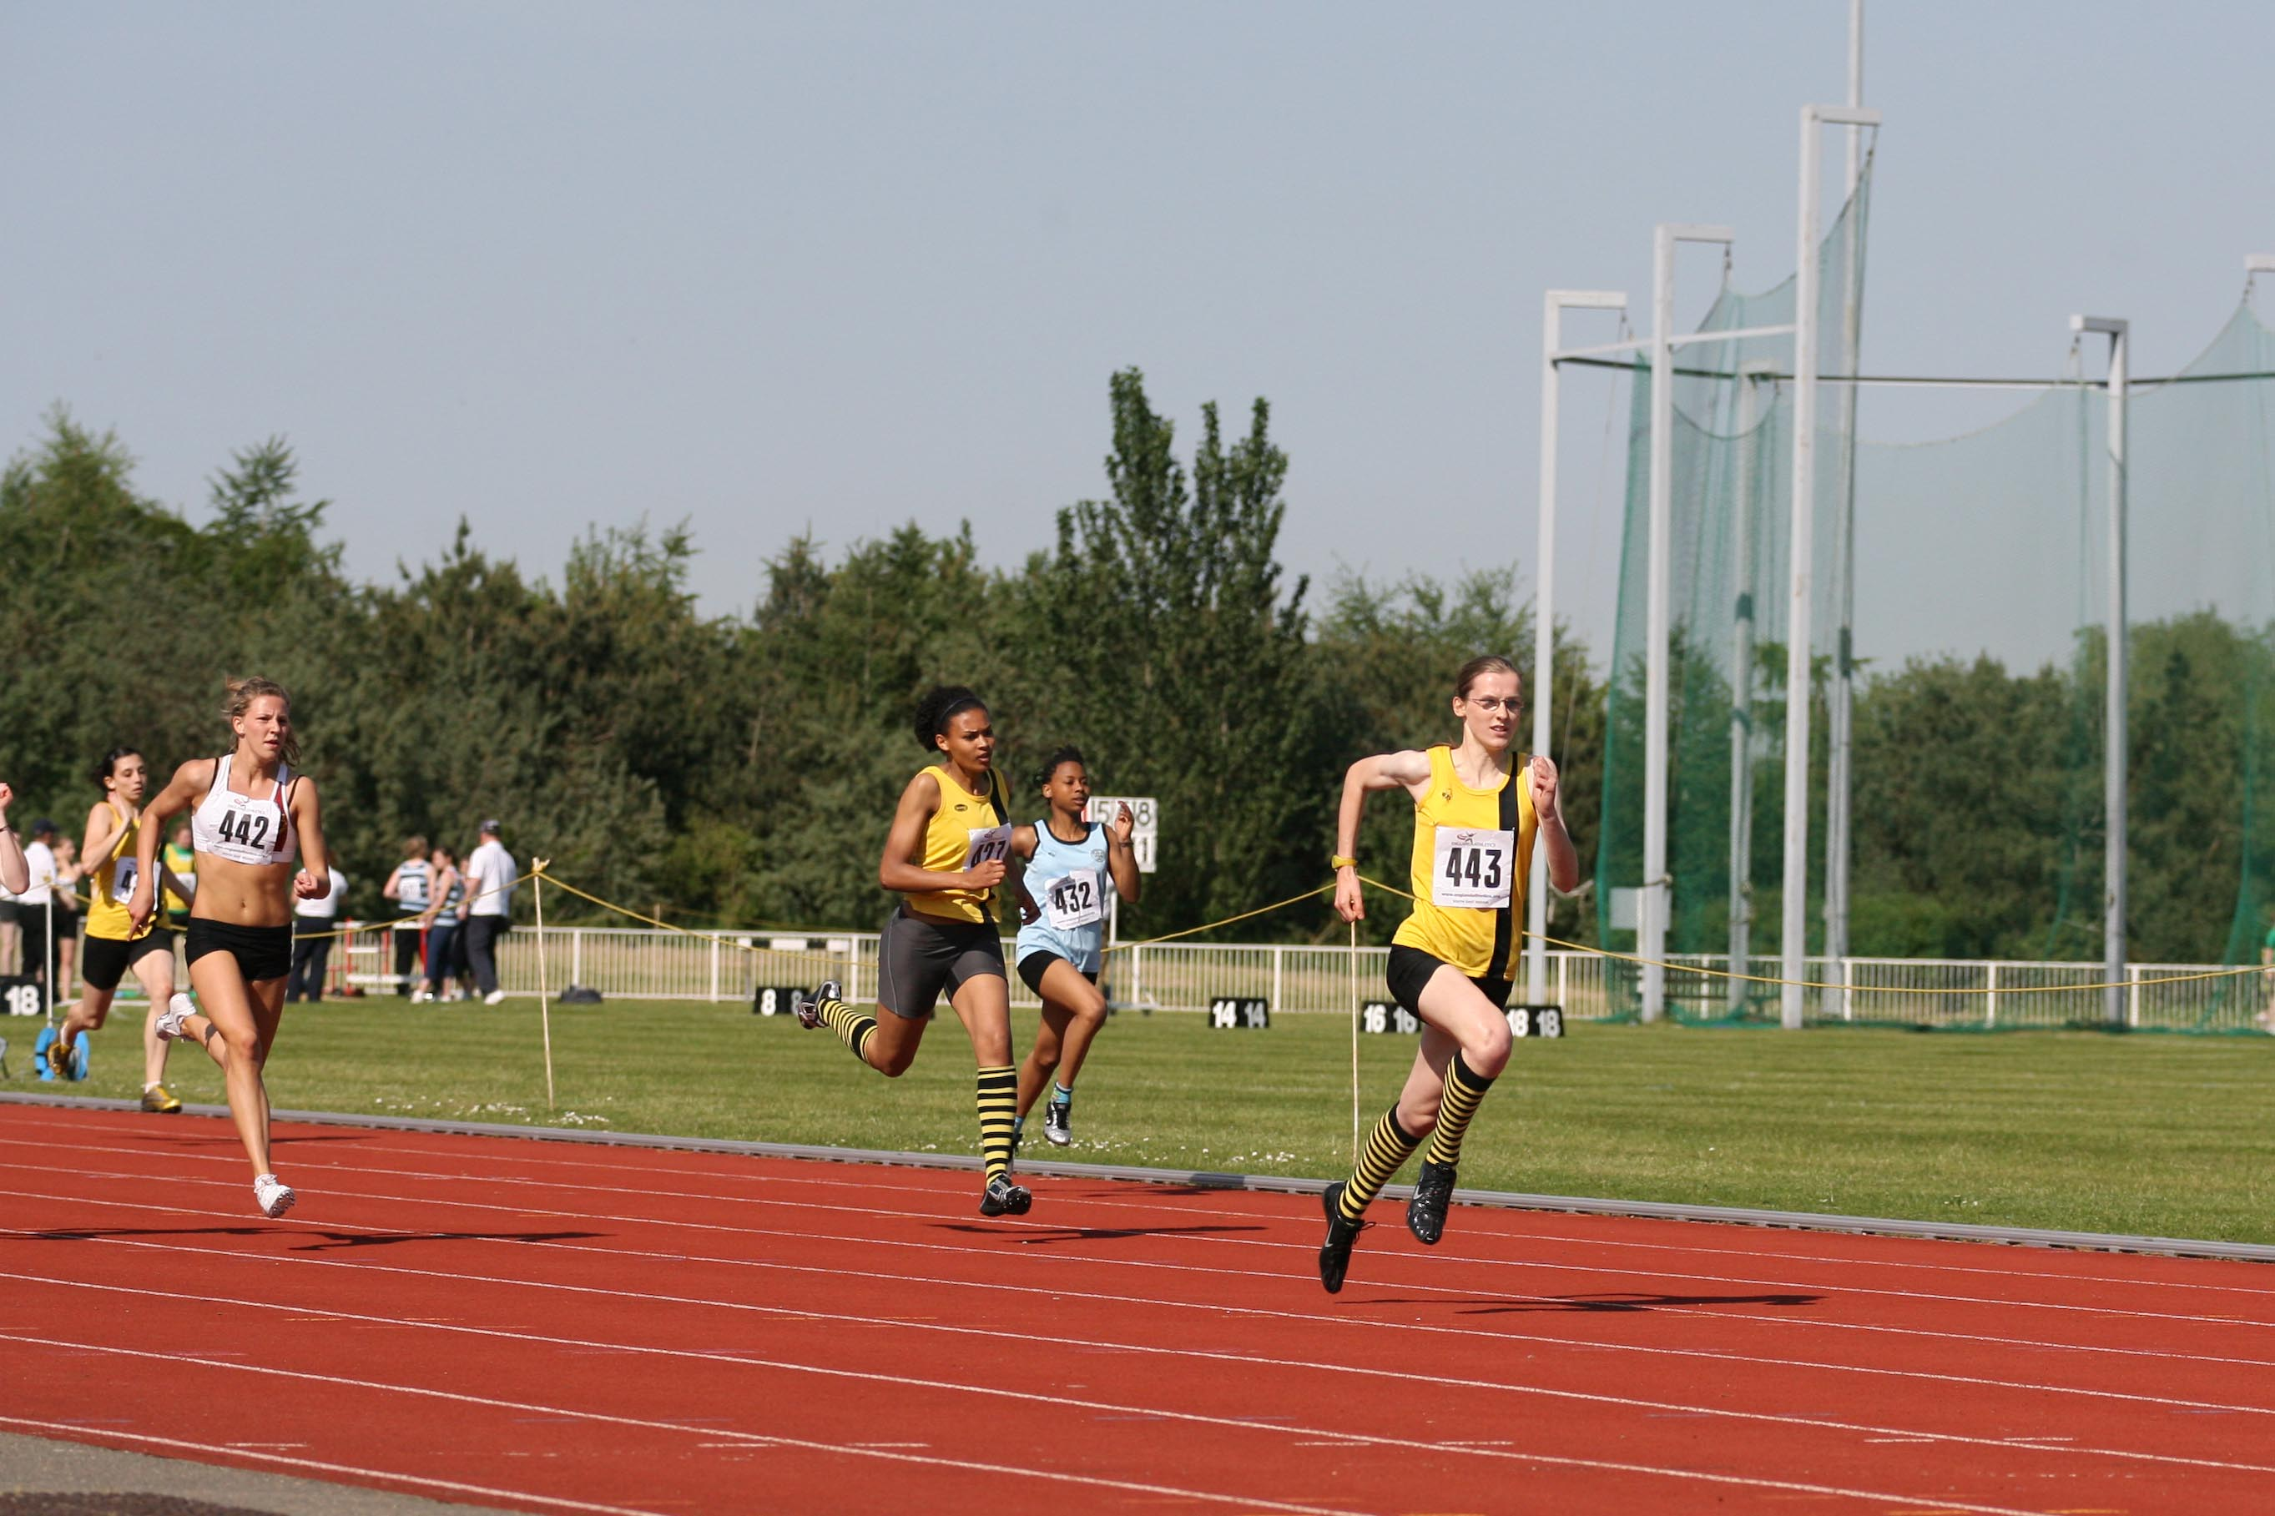
The Julie Rose Stadium

Slide 16
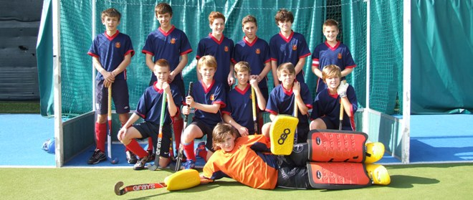
Ashford Hockey and Sports Club

Slide 17
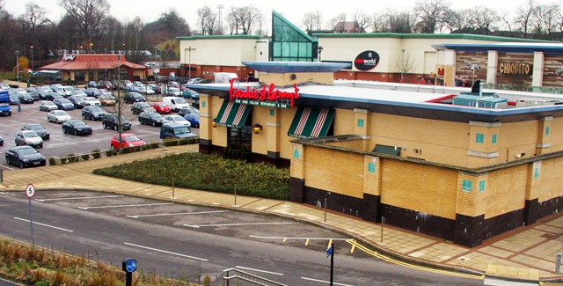
Eureka Park

Slide 18
Thank you for listening to our presentation about Ashford. We hope you are looking forward to visiting!
From the Godinton staff and children

